Slide 1

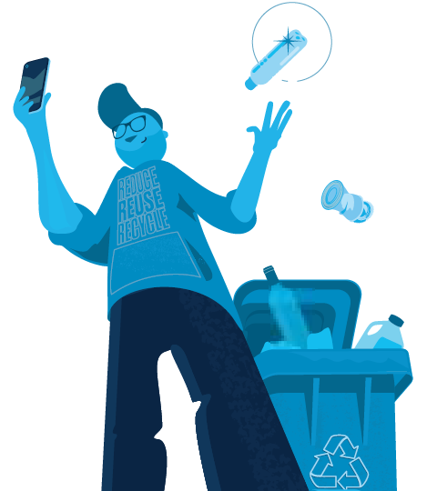

What Goes in My Carts?
Department of Waste Management and Recycling
Doug Eubanks, WM Program Associate
Nellie Tarverdyan, WM Program Assistant
SacGreenTeam@SacCounty.gov​

Slide 2
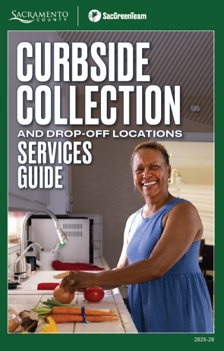
Who We Are …
Own and operate the North Area Recovery Station, Kiefer Landfill, and drop-off facilities for household hazardous waste
Provide curbside collection service for garbage, recycling, organics, used oil/used oil filters, and bulky waste to over ~160,000 single family/duplex homes in the unincorporated County.
  Every June, we mail out a Service Guide to all our residents.

Slide 3
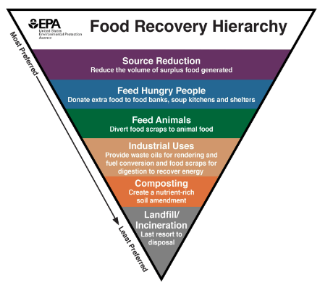
Why We Recycle - State Law
SB1383
Divert organic material from landfills so it can be used for more beneficial uses such as animal feed, compost, biogas, etc.
The organic material we collect becomes free compost available to our residents!
AB 939
CA jurisdictions are required to divert 50% of their waste stream from landfill disposal every year.

Slide 4
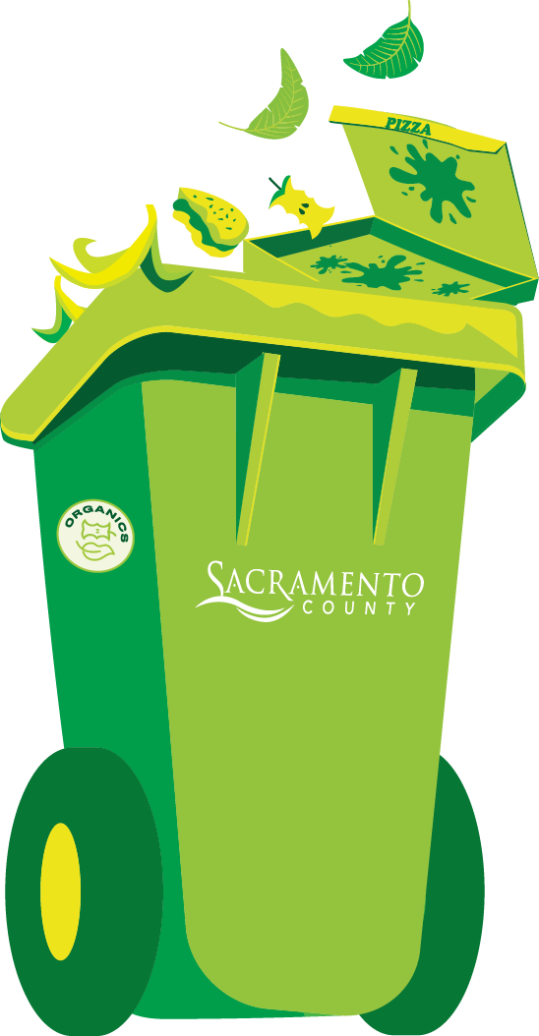
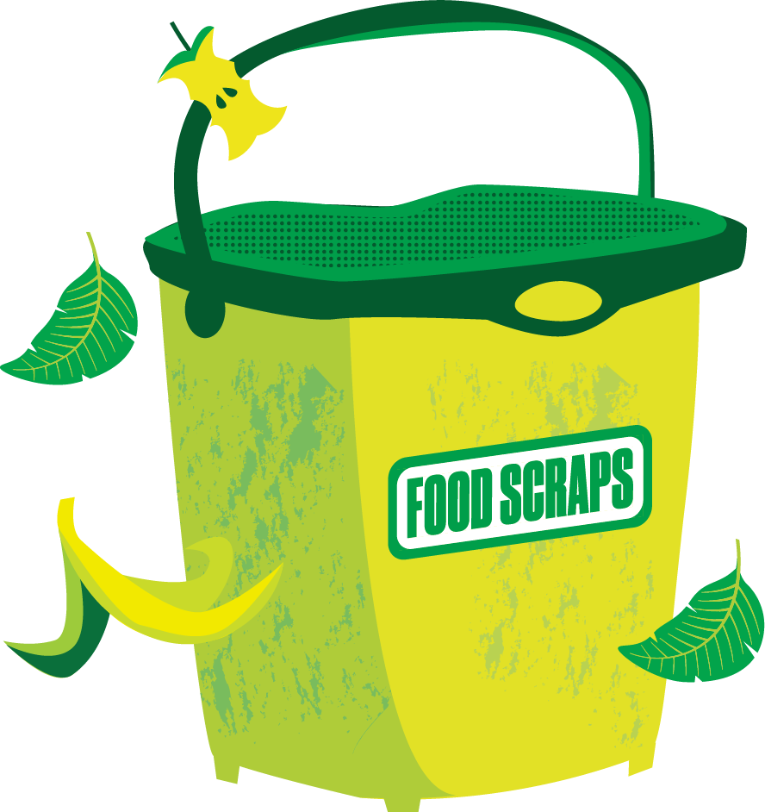
Organics Collection

Slide 5
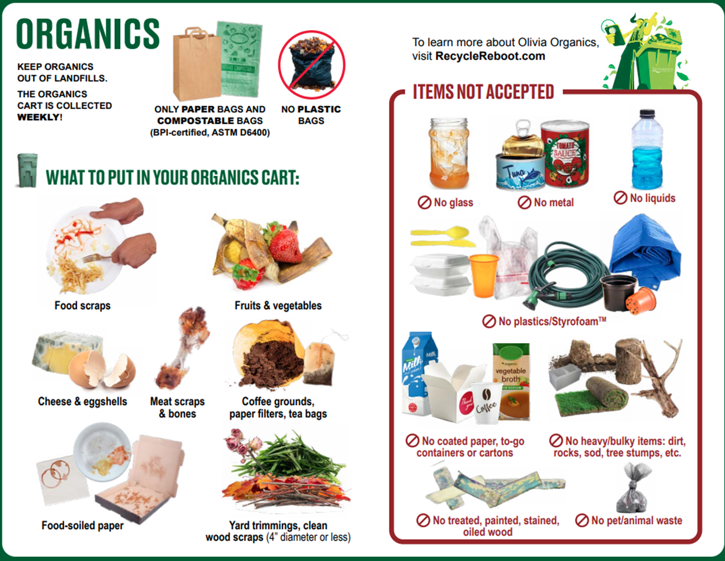

Slide 6

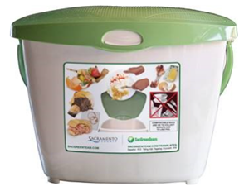
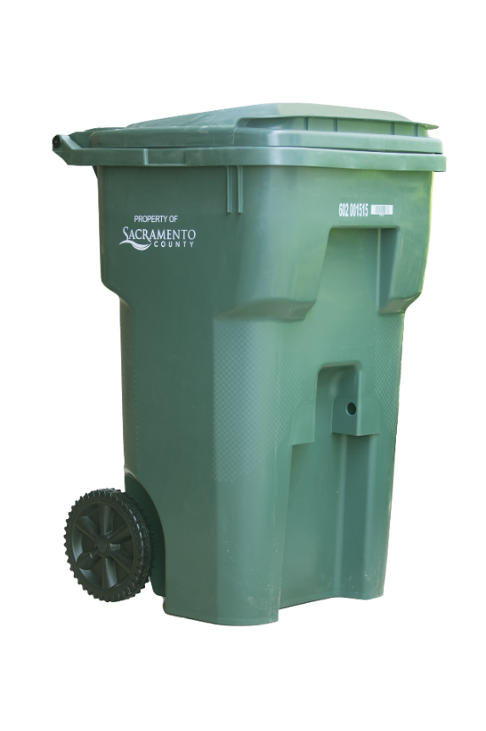
Organics Cart Tips
Use a kitchen pail or another container to collect food scraps and food-soiled paper
  Line the kitchen container with a paper bag, newspaper or BPI-Certified (meets ASTM D6400 standards) compostable bag. No plastic bags!
Drain food scraps of liquid
Freeze or refrigerate food scraps
Sprinkle food scraps with baking soda
Line Organic cart with leaves, grass clippings, or paper (brown paper bags or newspaper)
Occasionally rinse the Organics cart
Place Organics cart for collection EVERY WEEK even if not full

Slide 7

Recycling Collection

Slide 8
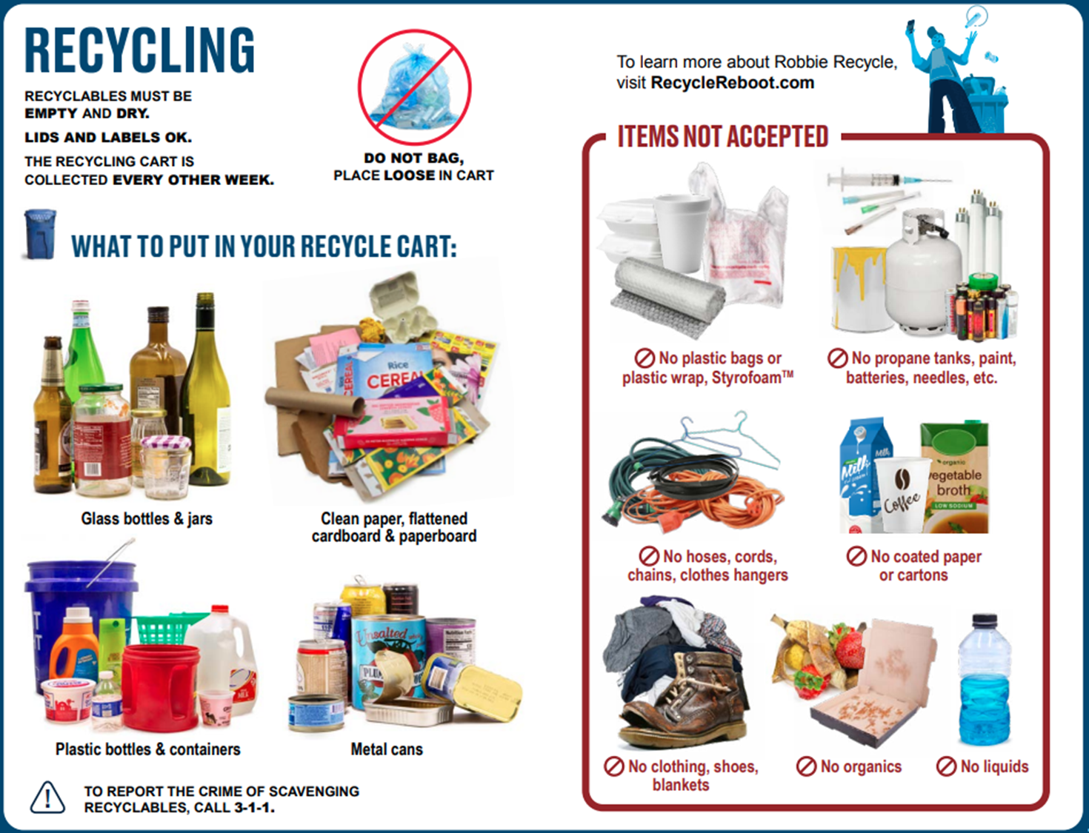

Slide 9

No Plastic Bags in the Recycling Cart!

Slide 10


Garbage Collection

Slide 11
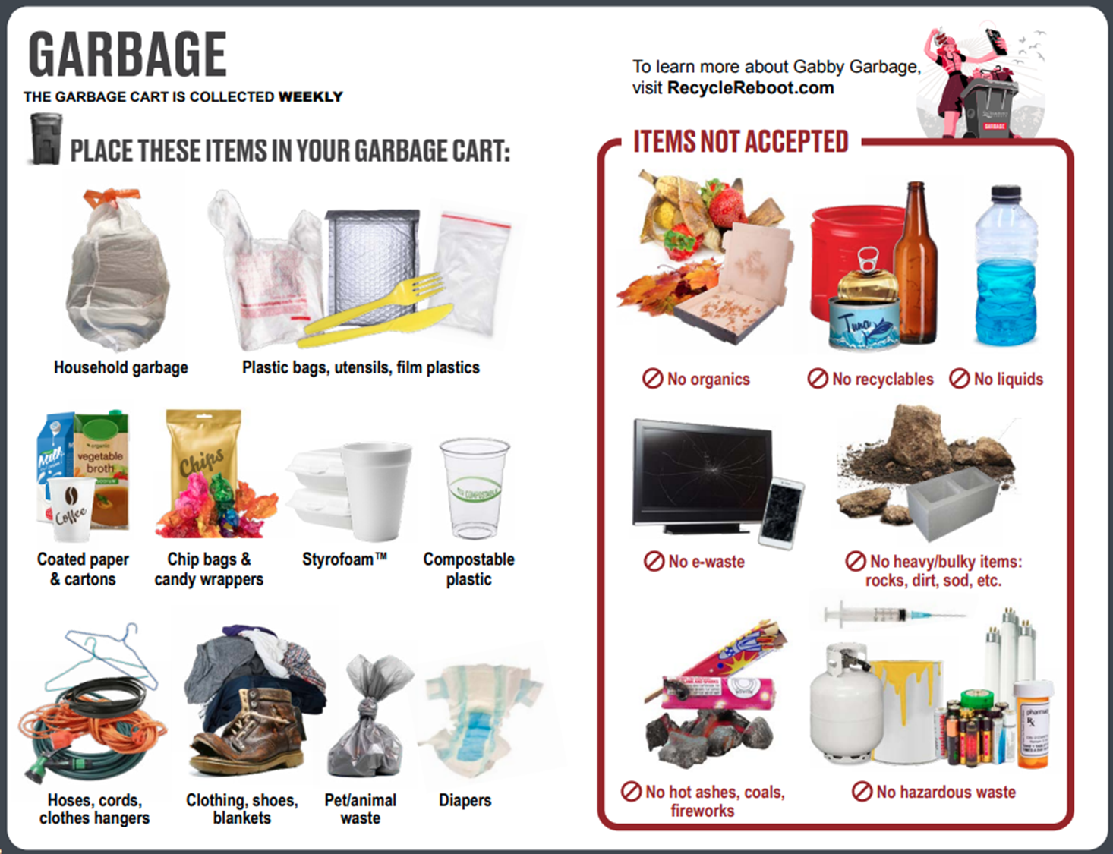

Slide 12
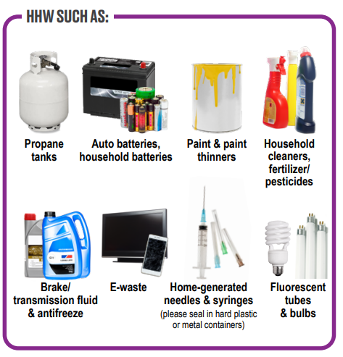
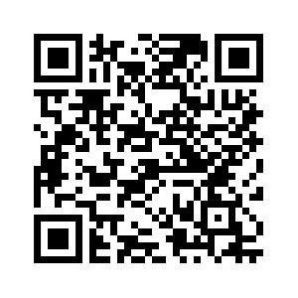
Household Hazardous Waste & ABOP
Visit SacGreenTeam.com for a list of free drop-off locations:

Slide 13
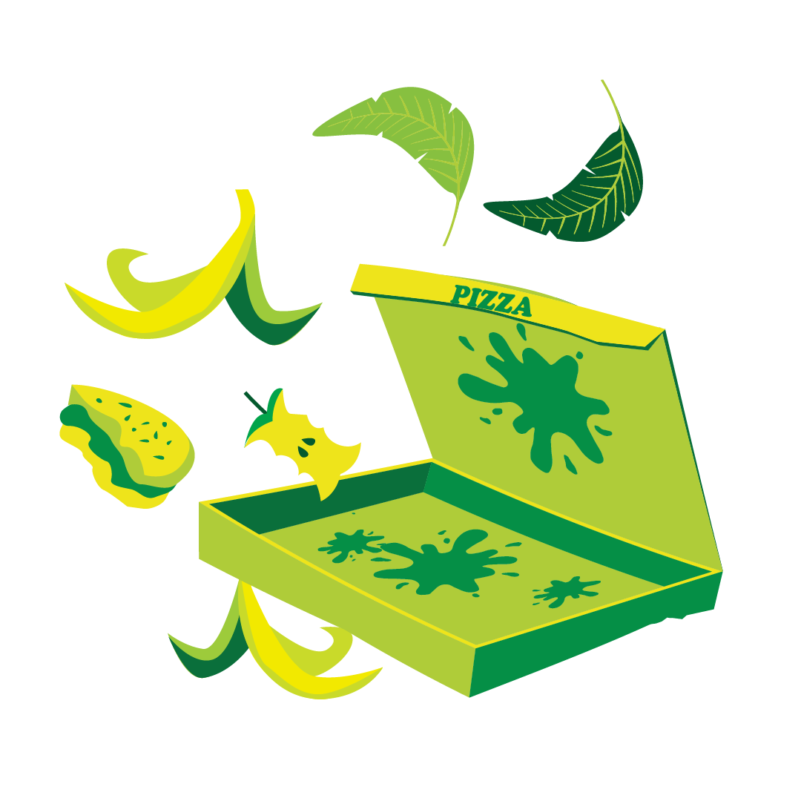
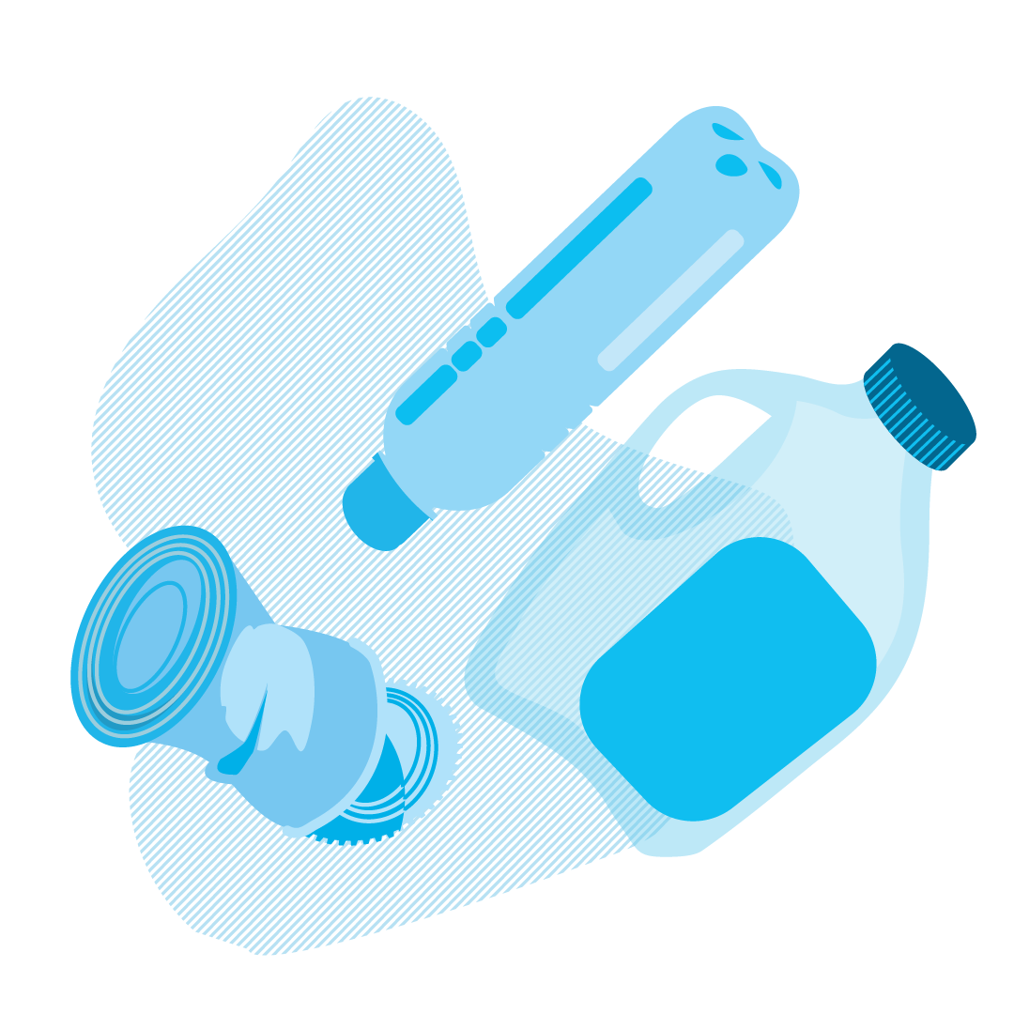

What it Becomes
Organics
(Food Scraps, Food-Soiled Paper, & Yard Trimmings)
Industrial Composting Facility
Compost
Local Vendor for Processing & Distribution for Recycling Markets
Becomes a New Product (Based on Market Demand)
Recyclables
(Paper, Cardboard & Paperboard, Plastic Bottles & Containers, Metal Cans, & Glass Bottles & Jars)
Landfill –
Last Resort
We need to preserve the landfill by reducing what gets thrown away!
Garbage
(Household Garbage, Plastic Bags, Diapers, Pet Waste, Etc.)

Slide 14
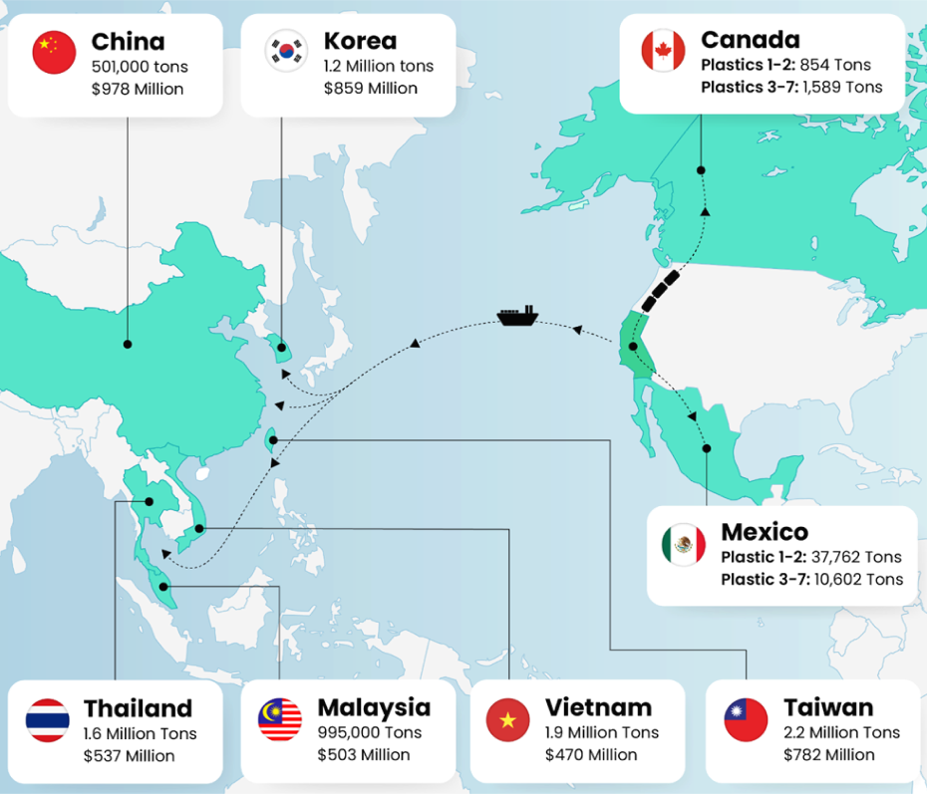
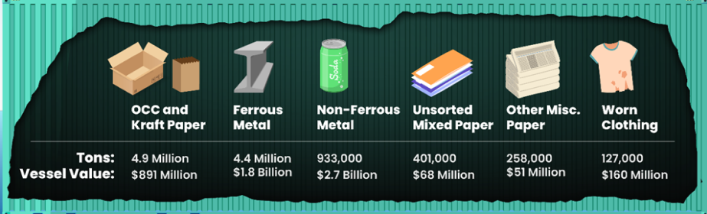
California’s Recycling Exports (2022)
Key Takeaways:
California exported 11.3 million tons of recyclable materials to foreign countries.
In contrast to the more than 13 million tons of recyclable material imported by China in 2011, China imported less than a million tons in 2022.
In 2022, California exported less than 50 thousand tons of plastic scrap, compared to almost 1.3 million tons in 2014.
Recyclable Material Being Exported

Slide 15


Download the free SacGreenTeam App!
View your Collection & Street Sweeping Calendar
Sign up for Service Reminders
Play the Sort Smart Game!
Use the “How do I get rid of” Search Tool
15

Slide 16
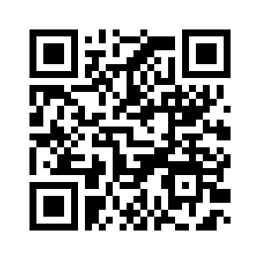
Questions & Contact
For more information, please visit:
SacGreenTeam.com
RebootRecycle.com
Email: sacgreenteam@saccounty.gov
For service-related questions:
Call: 916-875-5555

