Slide 1
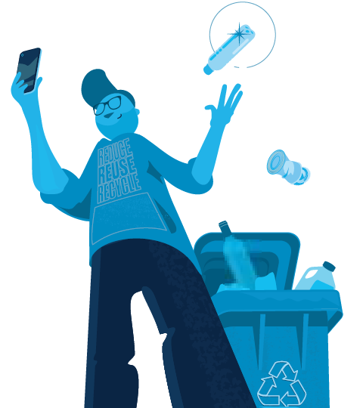
What Goes in My Carts?
Department of Waste Management and Recycling
SacGreenTeam@SacCounty.gov​

Slide 2
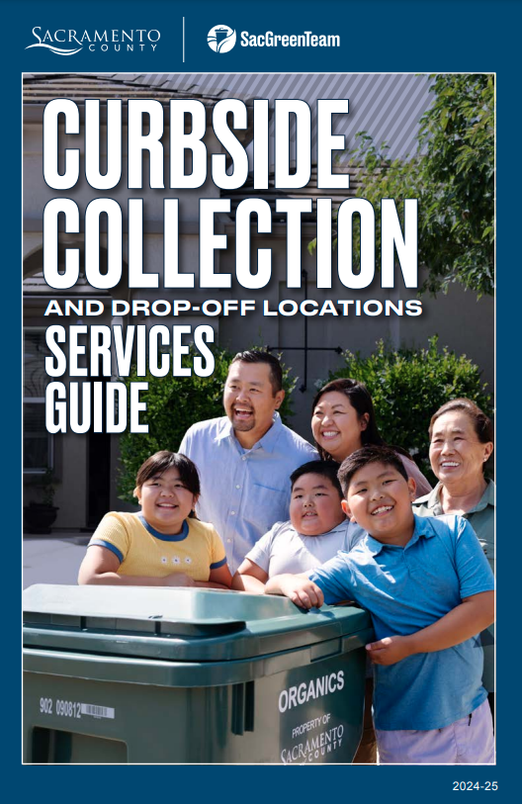
Who We Are …
Own and operate the North Area Recovery Station, Kiefer Landfill, and drop-off facilities for household hazardous waste
Provide curbside collection service for garbage, recycling, organics, used oil/used oil filters, and bulky waste to over ~160,000 single family/duplex homes in the unincorporated County.
Every June, we mail out a Service Guide to all our residents.

Slide 3
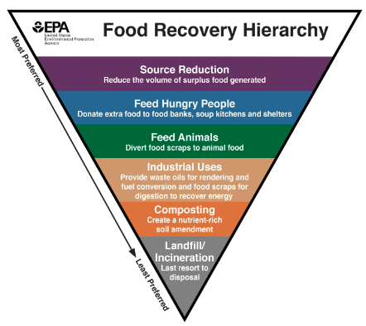
Why Recycle Organics?
State Law – SB1383
Divert organic material from landfills so it can be used for more beneficial uses such as animal feed, compost, biogas, etc.
Goals
Reduce methane generation at landfills
Reduce organic waste disposal 50% by 2020 and 75% by 2025
Recover 20% of currently disposed surplus edible food by 2025
The organic material we collect becomes free compost available to our residents!

Slide 4
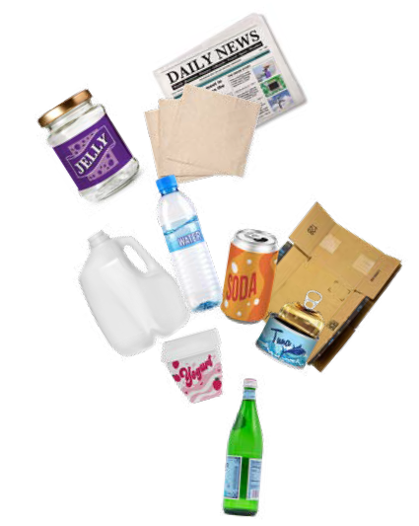
Why Recycle?
State Law – AB 939
CA jurisdictions are required to divert 50% of their waste stream from landfill disposal every year.
Goals
Reduction in landfill waste
Conservation of resources
Energy saving
Sustainability

Slide 5
Organics Collection

Slide 6
Organics My Way – The Tcha Family

Slide 7
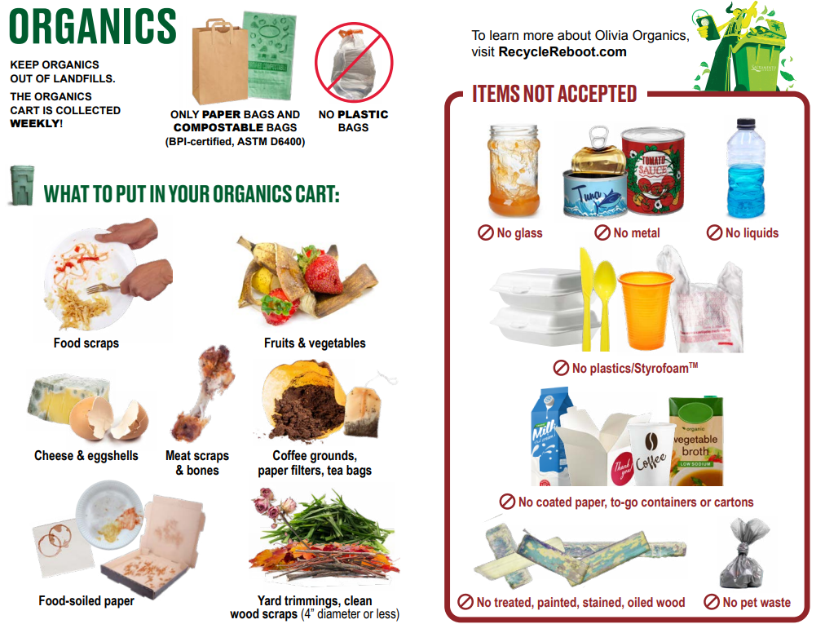

Slide 8
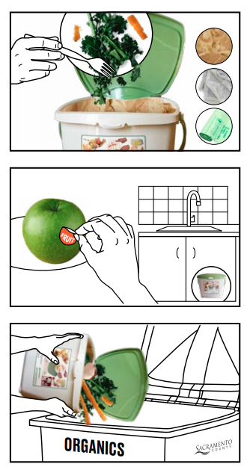
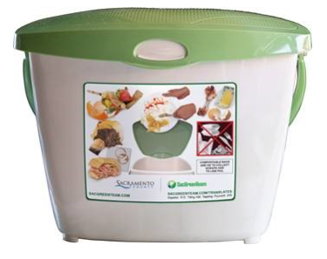
Countertop Kitchen Pail for Organics
Collecting Organics at Home!
Use a kitchen pail for collecting food scraps and food soiled paper
Optional: Line the kitchen container with a paper bag, newspaper or BPI-Certified (meets ASTM D6400 standards) compostable bag. No plastic bags!
While supplies last, free kitchen pails available. Visit SacGreenTeam.com for information on how to pick one up.

Slide 9
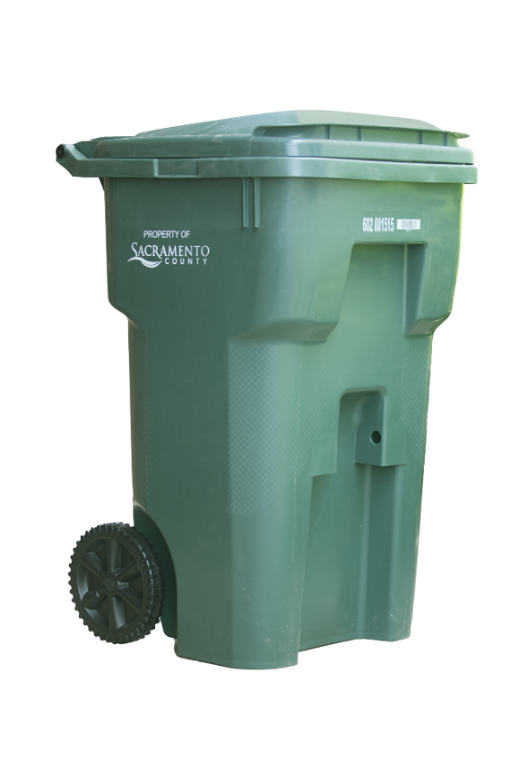
Organics Cart Tips
Drain food scraps of liquid
Freeze or refrigerate food scraps
Place food scraps in a paper bag or proper compostable bag before adding to Organics cart
Sprinkle food scraps with baking soda
Line Organic cart with leaves, grass clippings, or paper (brown paper bags or newspaper)
Occasionally rinse the Organics cart
Place Organics cart for collection EVERY WEEK even if not full

Slide 10
Recycling Collection

Slide 11
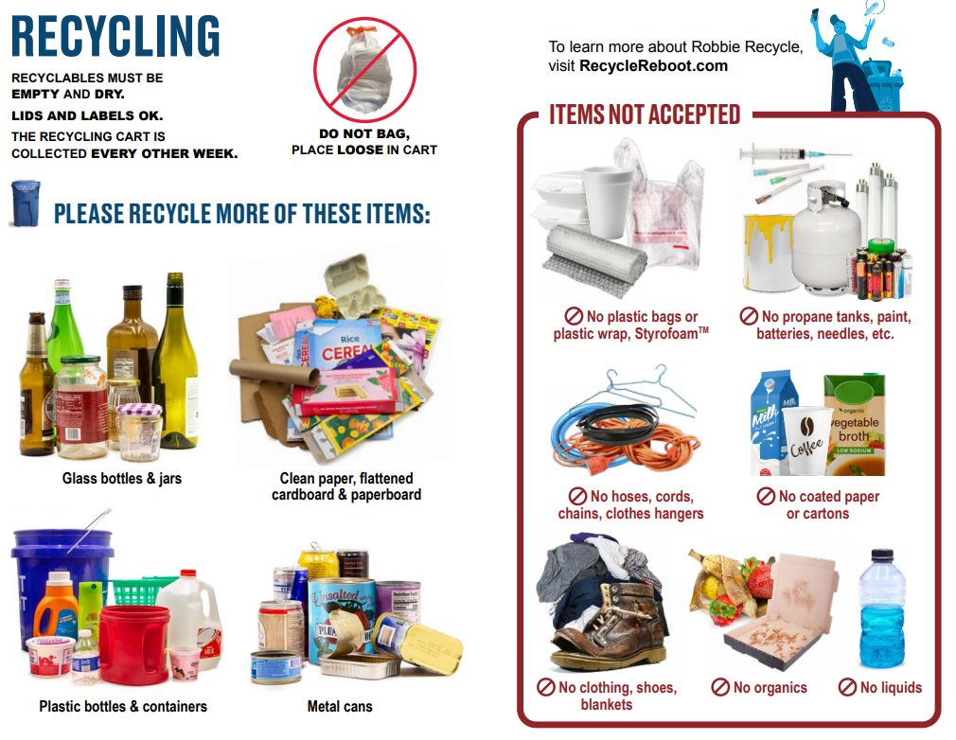

Slide 12
No Plastic Bags in the Recycling Cart!

Slide 13
Garbage Collection

Slide 14
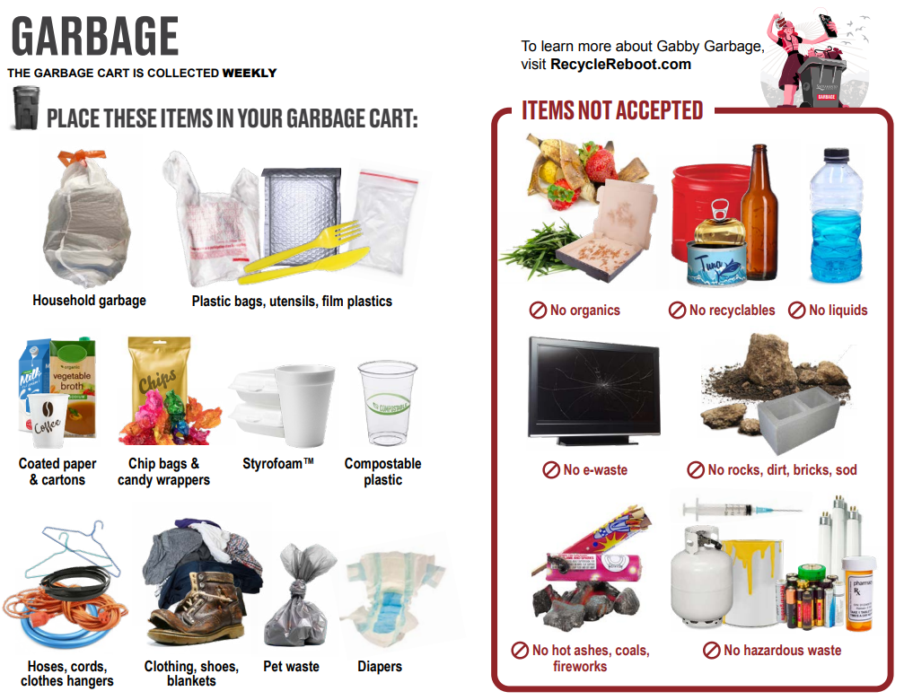

Slide 15
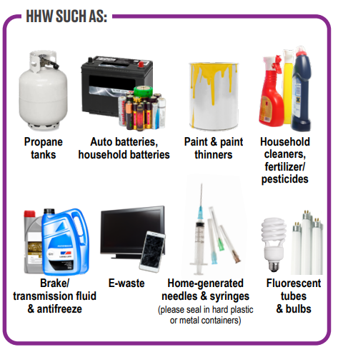
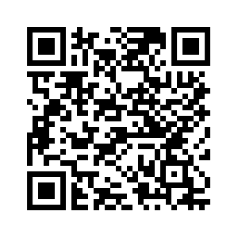
Household Hazardous Waste & ABOP
Visit SacGreenTeam.com for a list of free drop-off locations:

Slide 16
Cart Set Out
Place carts at curb no later than 6 AM on your scheduled collection day (holidays included)
Place carts at least 6 feet from cars, mailboxes, basketball hoops, and other objects

Slide 17
SacGreenTeam App
Download the free SacGreenTeam App today!
Collection calendar
Service reminders
Bulky waste appointments
Street sweeping schedule
Play the Sort Smart game!
“How do I get rid of” search tool
17

Slide 18
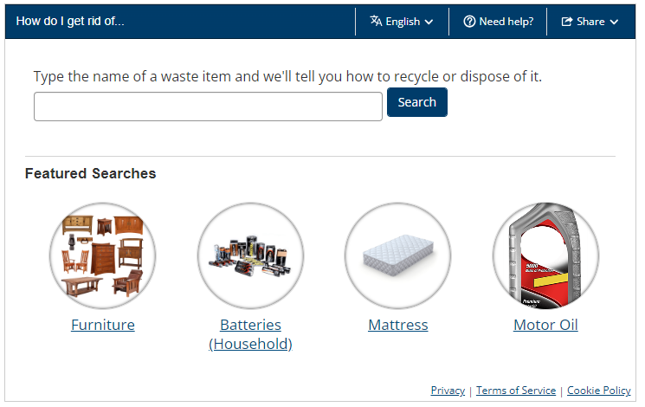
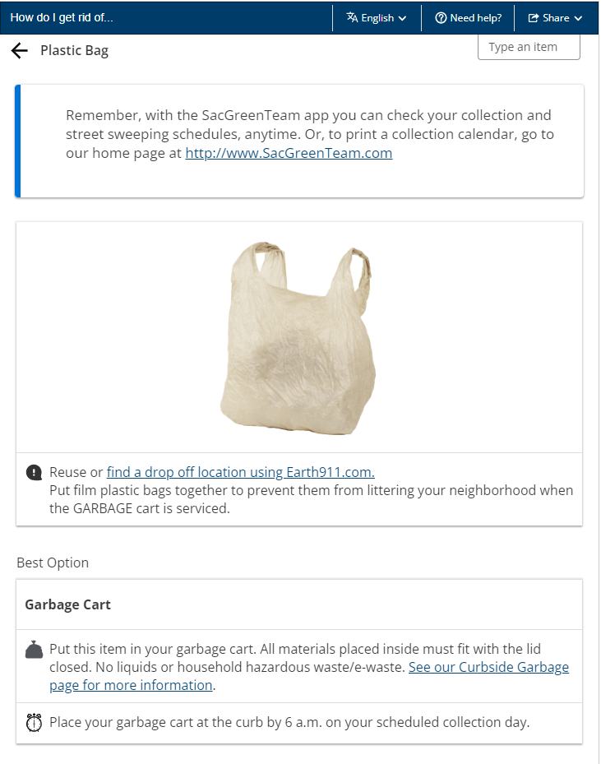
How Do I Get Rid Of… Search Tool
Use our App or Website to Search for Disposal Options!
18

Slide 19
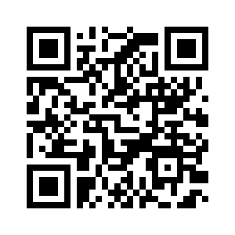
Questions?
Questions & Contact
For more information, please visit:
SacGreenTeam.com
RebootRecycle.com
Email: sacgreenteam@saccounty.gov
For service-related questions:
Call: 916-875-5555

