Slide 1


INSTRUCTIONS:
This PowerPoint can be used to educate tenants on how to correctly sort and separate organic material and recyclables from the garbage. Property managers may provide the entire presentation or select slides to tenants.
To have a Sacramento County staff member provide a free, live presentation to tenants, property managers should contact CommercialWaste@SacCounty.gov.

Slide 2
Organics, Recycling, and Garbage Collection at Multifamily Properties
Department of Waste Management & Recycling

Slide 3

Sacramento County - Department of Waste Management & Recycling (DWMR).
DWMR regulates commercial solid waste collection services by commercial franchised haulers that provide garbage, recycling, and organics collection services for multifamily properties located in the unincorporated areas of Sacramento County.
DWMR created this presentation as an educational resource to tenants.

Slide 4
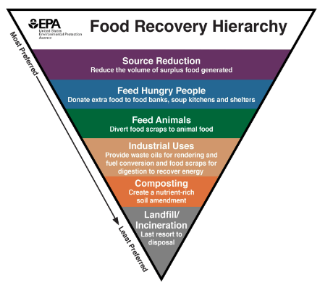
SB 1383: Reducing Short Lived Climate Pollutants
State law
Divert organic material from landfills so it can be used for more beneficial uses such as animal feed, compost, biogas, etc.
SB 1383 Goals
Reduce methane generation at landfills
Reduce organic waste disposal 50% by 2020 and 75% by 2025
Recover 20% of currently disposed surplus edible food by 2025

Slide 5
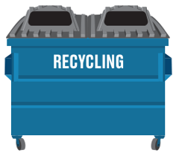
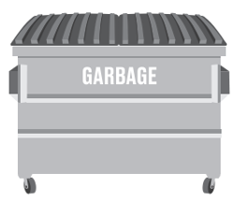

Your Multifamily Property Should:
Have an organics, recycling, and garbage container at all enclosures
Have containers consistently available for tenant use.
Make sure all organics, recycling, and garbage containers are labeled.
Have bulky waste (furniture, mattresses, etc.) removed on an on-call or more frequent basis to avoid overflow and unsafe accumulation outside of the waste containers.
Educate tenants within 14 days of move-in and annually on how to correctly separate their waste materials for recycling.

Slide 6
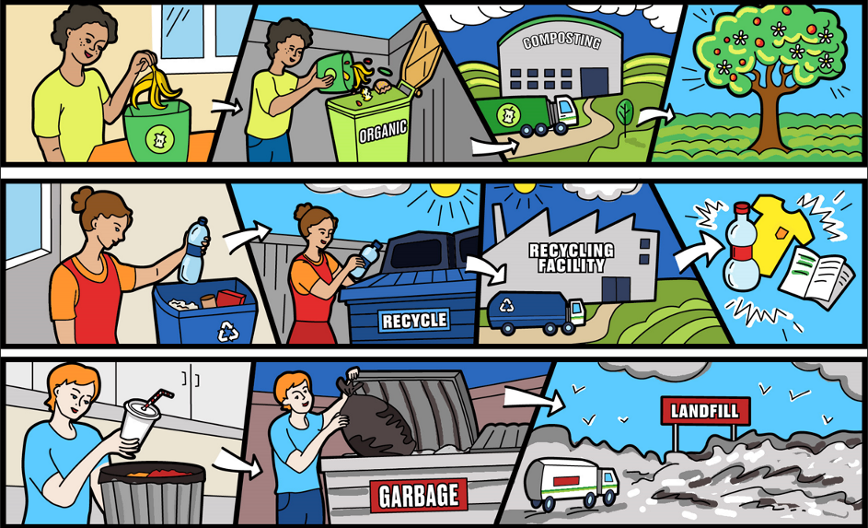
As a tenant, you play an important role by…
Sorting items before taking them to the waste enclosure
Placing all items inside the correct container and not leaving anything on the ground!
Encouraging others to do the same!

Slide 7
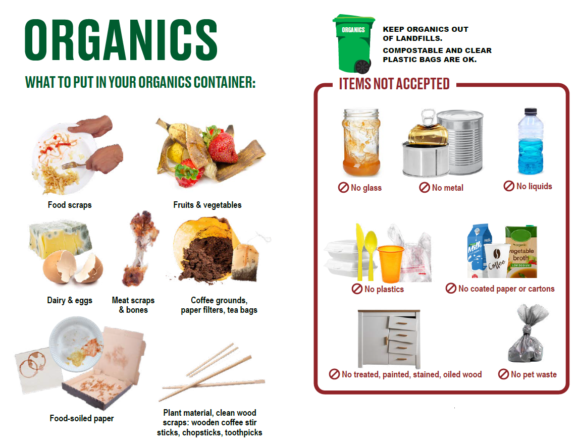

Slide 8
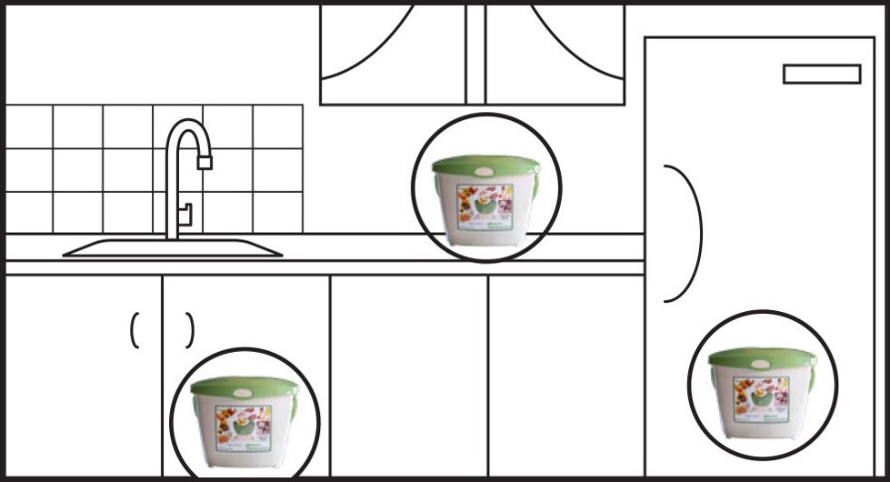
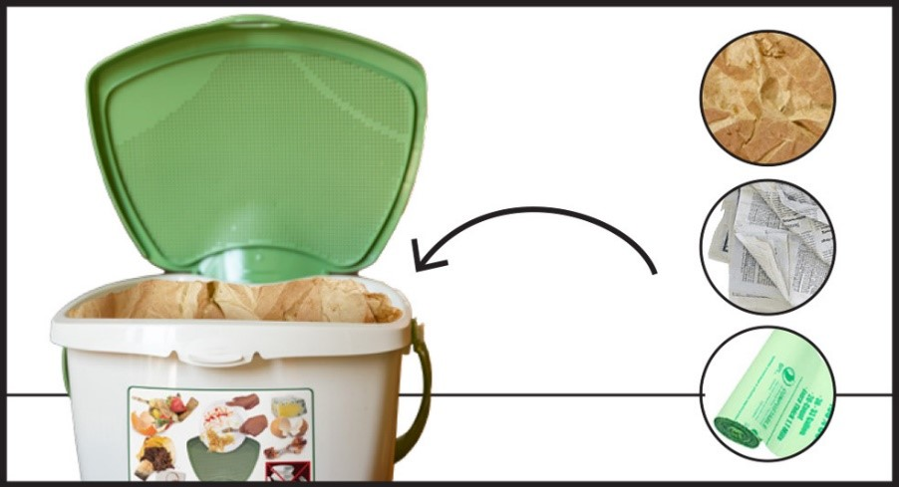


Use a Kitchen Pail or other reusable container and…
Store the container in a convenient location (under sink, on the countertop, or in the refrigerator or freezer)
Line the container with paper or a compostable bag
Prepare the food scraps by:
Draining excess liquid
Removing stickers, twist ties, rubber bands, and plastic wraps
Layering food-soiled napkins with food scraps
Sprinkling baking soda on food scraps
FREQUENTLY empty the container into your property’s Organics container to avoid odor and pests
1
2
3
4

Slide 9
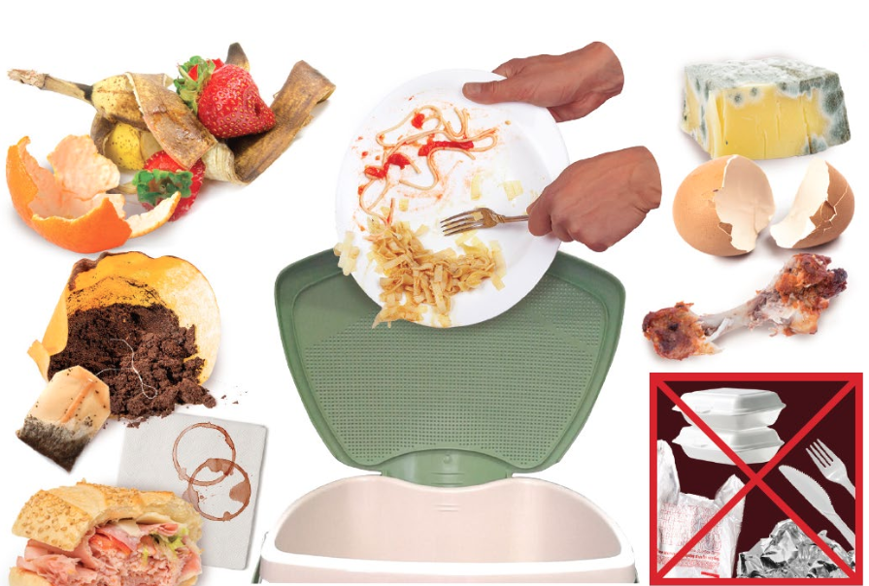
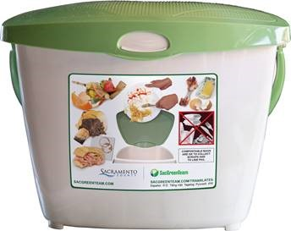
Countertop Kitchen Pail for Organics
10863 Gold Center Dr., Rancho Cordova, CA 95670 - Monday-Friday, 8AM-4PM, closed holidays
(Free - While supplies last)

Slide 10
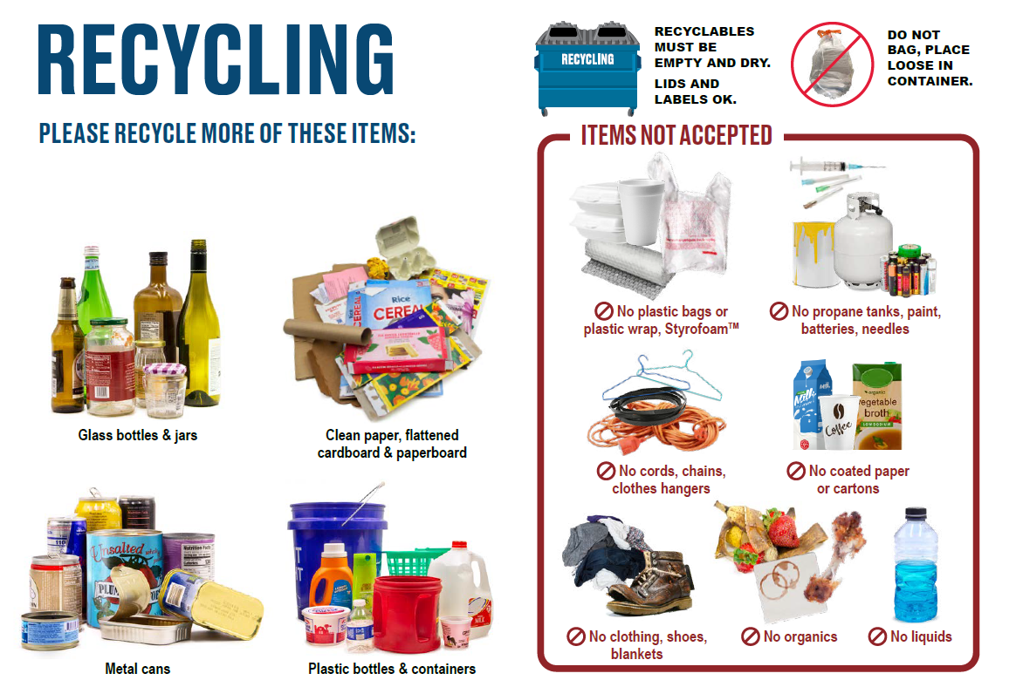


Slide 11
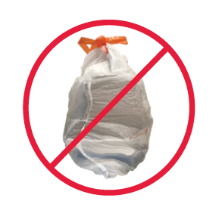
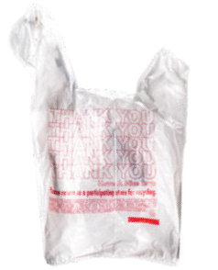
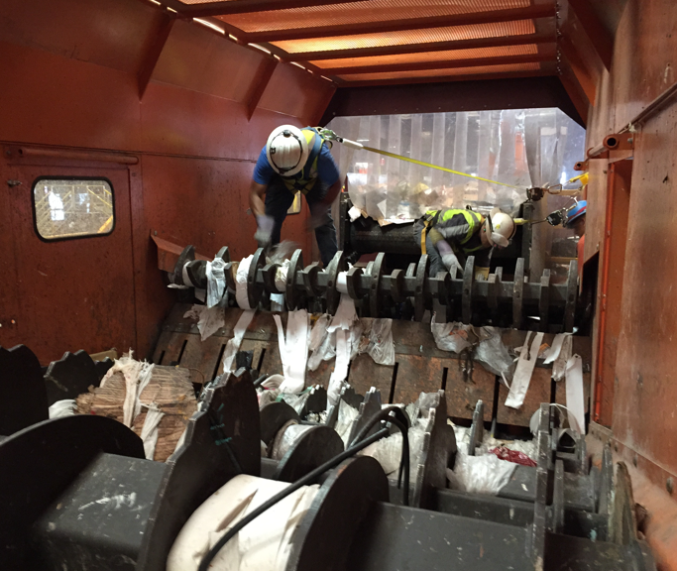
Don’t Bag Recyclables – Place Loose in Container
Film plastics and plastic bags should be reused or placed in the garbage container
Anything bagged does not get recycled

Slide 12
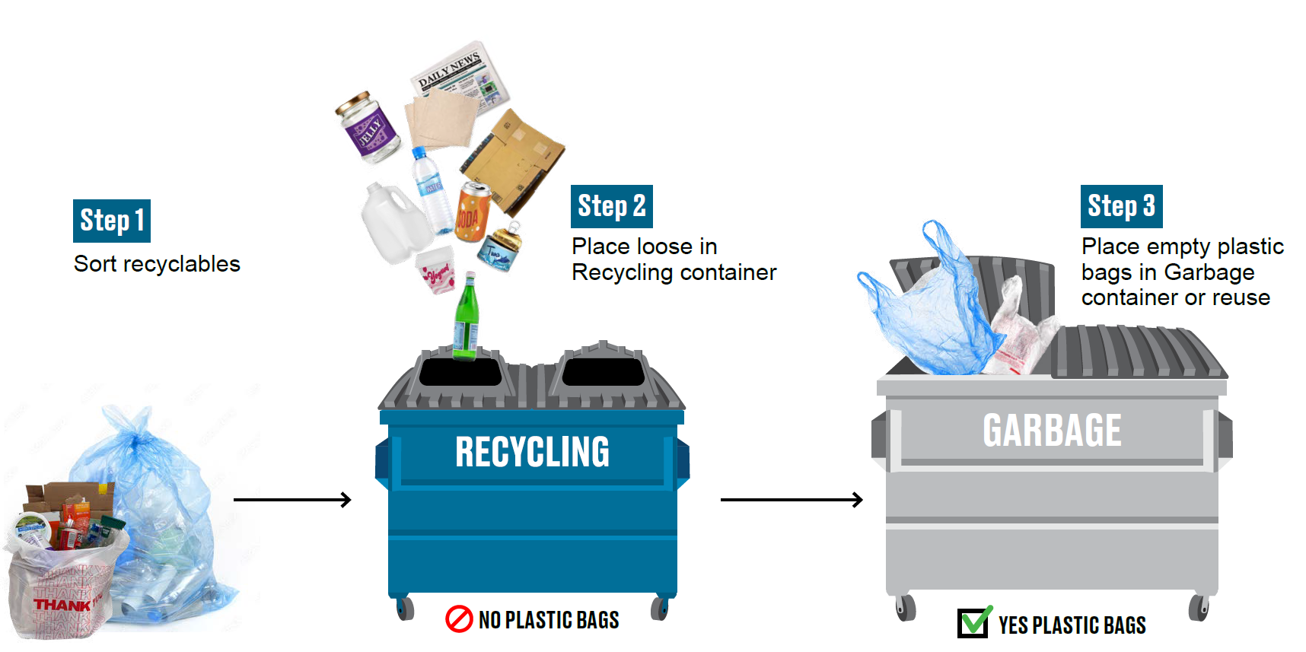
Don’t Bag Recyclables – Place Loose in Container

Slide 13
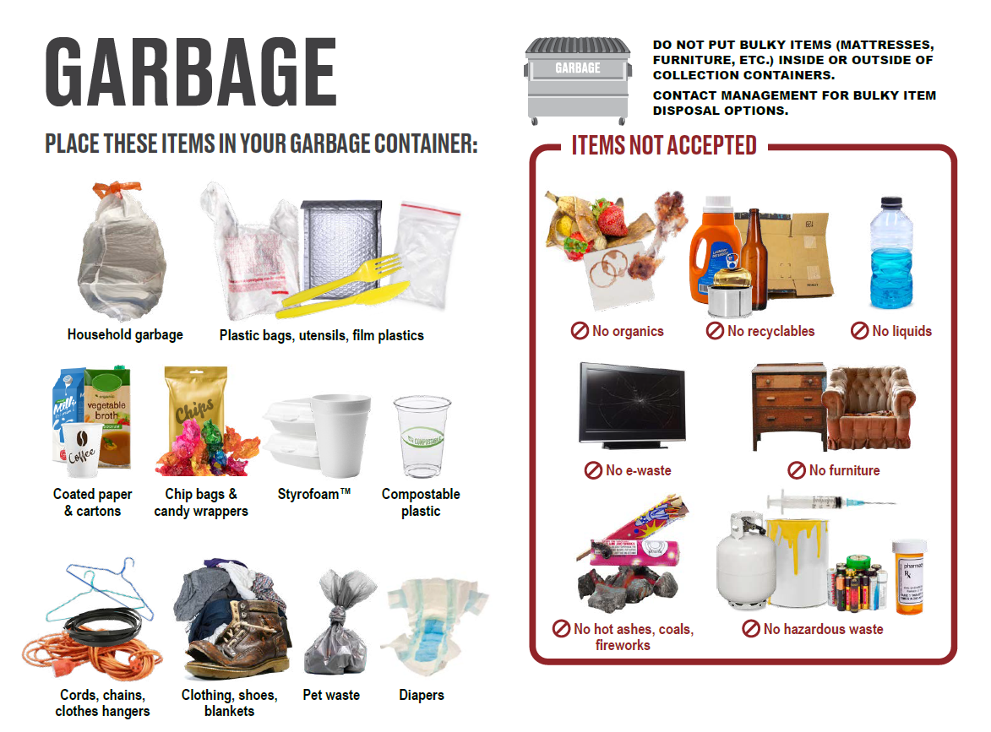

Slide 14
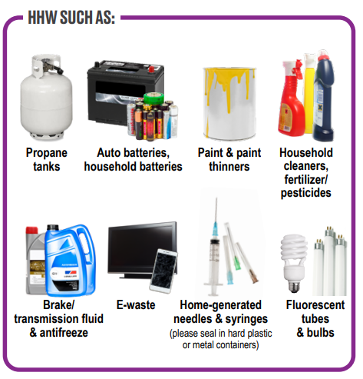

Household Hazardous Waste & ABOP
Visit SacGreenTeam.com for a list of free drop-off locations:

Slide 15
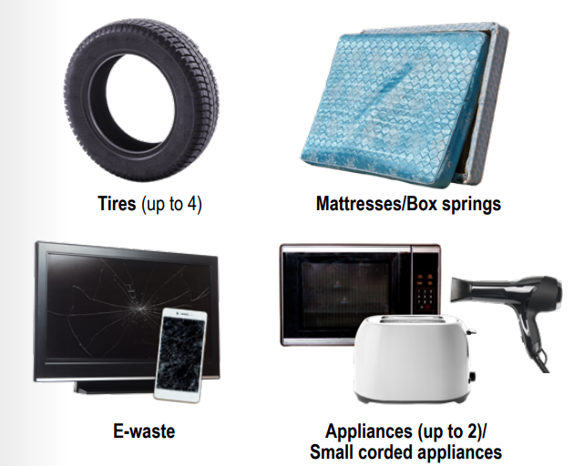

Free Drop-off Items
Accepted at either the North Area Recovery Station or Kiefer Landfill
Load must only include free items
Visit SacGreenTeam.com for more information

Slide 16

For more information, please visit: SacGreenTeam.com
Thank You!

